Slide 1
Helath Beneficiaries relocated based on Physicians and other Suppliers
Submitted by: Arun Jayakumar
Deep Nakum
Nitin Mali
Peppy
Submitted to: Prof. Aabhas Paliwal (Data analysis & Decision
Making)

Slide 2
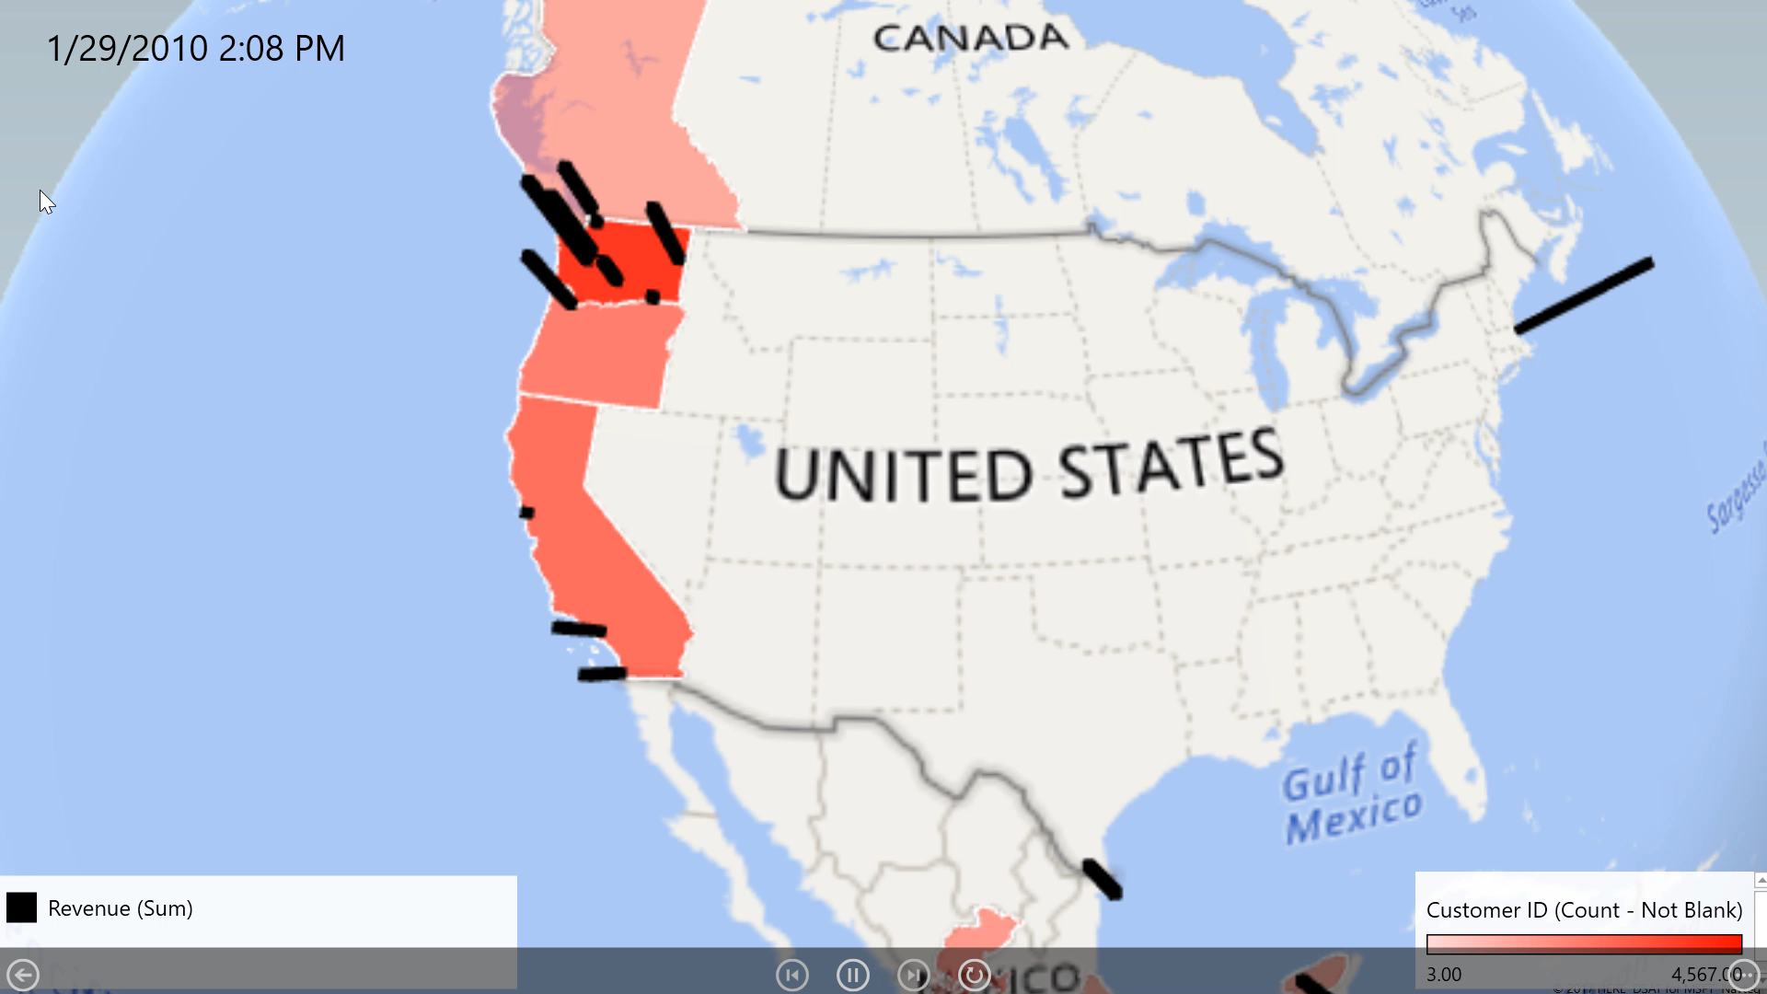
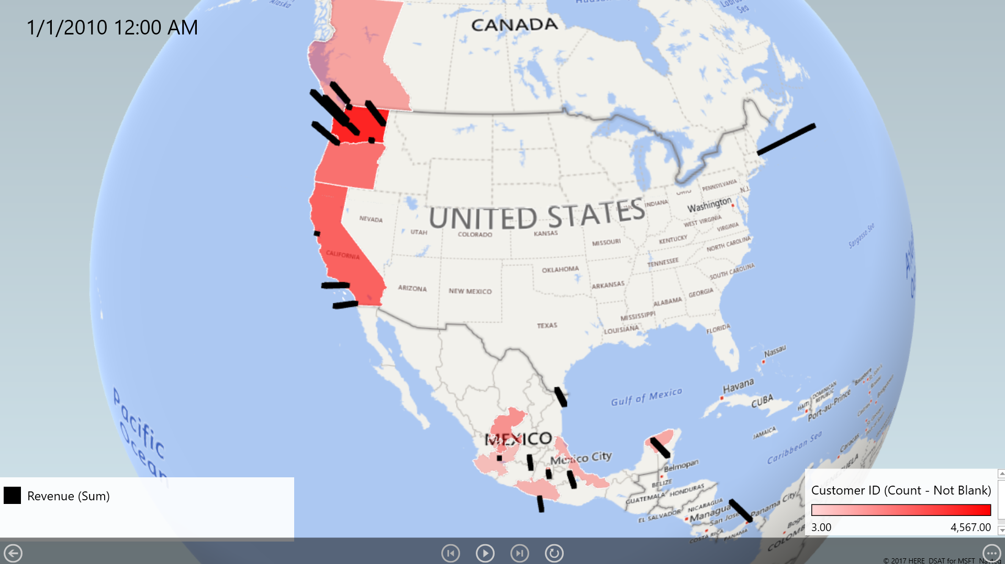

Slide 3
Highest participation of $10k-$30k and $30k-$50k Income group.
Emphasis on these customers can boost the revenue.
The graph describes a polynomial relationship.
R-squared 61.8%: predicts that the annual income can affect the revenue of the supermarket.
It is a statistical measure of how close the data are to the fitted line.

Slide 4
Second Highest Revenue in California
Lowest Revenue in SAN FRANCISCO
Reason : Less walk-in.
Only 14% Customer Conversion
13 people visited 2nd time
only 1 person has visited for 3rd time.

Slide 5
Snack food contribute 10% to
Canada revenue.
High Sale : May, July, September
Annual income of range 110k-130k belong only to May, July and September month.
The above point contribute to 1% of Canada’s revenue.
Promotion has to be made for this group.

Slide 6
Above graph insights says that the snacks and vegetables are the most sold ones.
Left one says that the Shop is being shut down in the month of December.
Right one says that the number of customers in Mexico city are very low which might result in shutting down.

Slide 7


